Slide 1


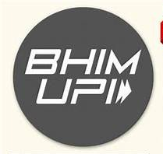



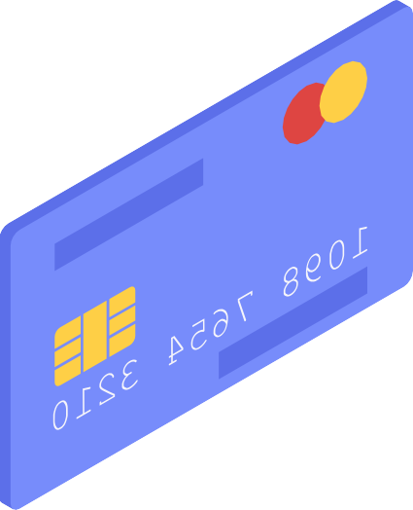
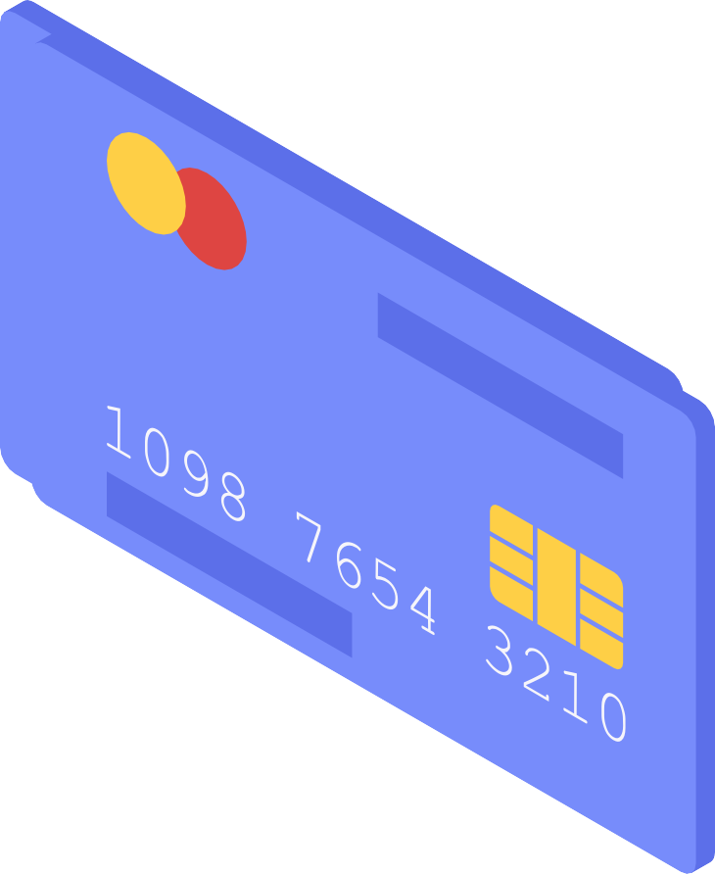

Analyzing UPI Apps and its Impact on Financial Transactions
Shital Yadav 908
Sujit Pal 912
Harshvardhan Bhosale 928

Slide 2

Objectives & Methodology
1
2
3
To compare the performance of various UPI apps based on key features such as security, speed, user interface, and customer support.
To identify the major factors influencing the adoption of UPI apps among users.
To analyze consumer satisfaction levels and their likelihood to recommend different UPI apps based on features.
Kruskal-Wallis Test
Factor Analysis
Binary Logistic Regression
Dunn Test
Chi-Square Test
Decision Tree

Slide 3
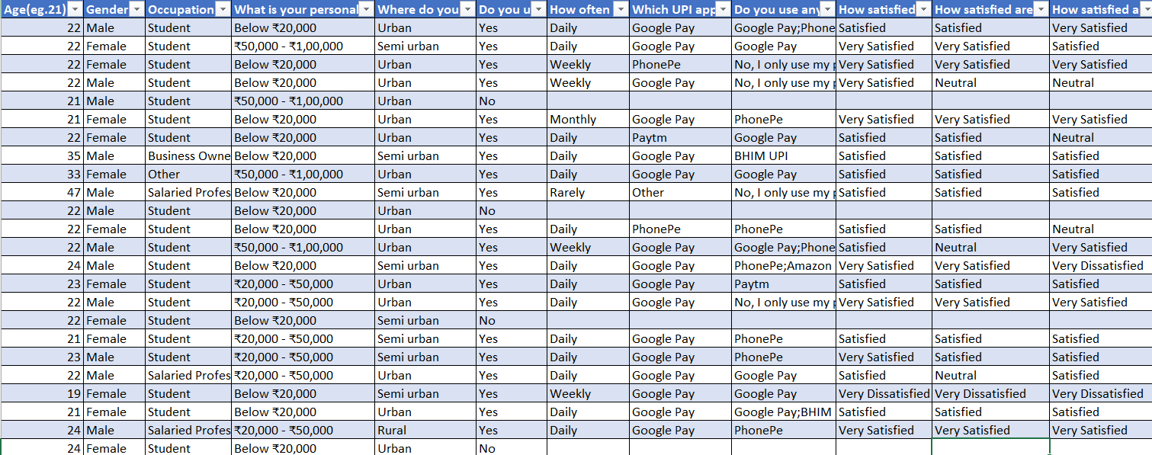


Data
22
No. of Questions
452
No. of Responses
49
No. of Columns
Click for Data

Slide 4
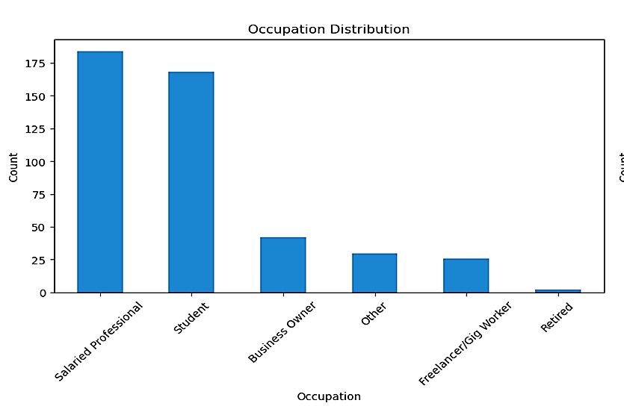
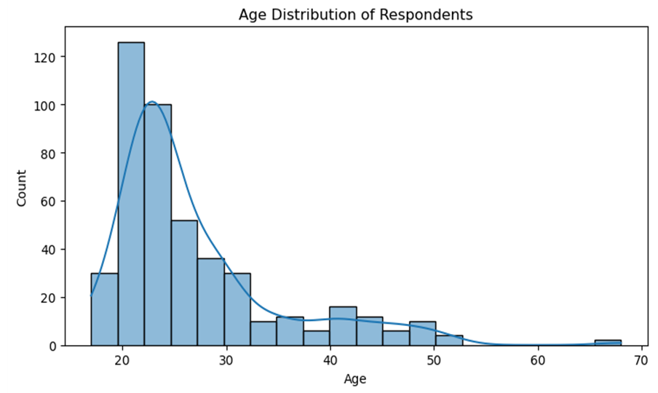
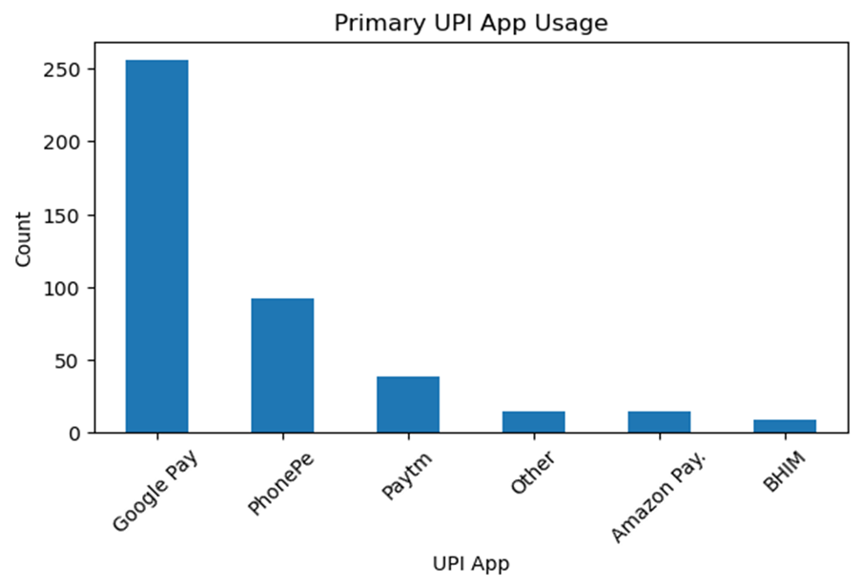
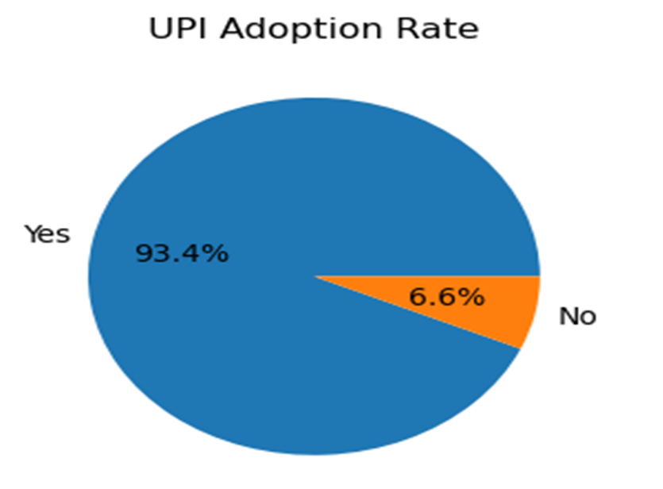
Visualization

Slide 5
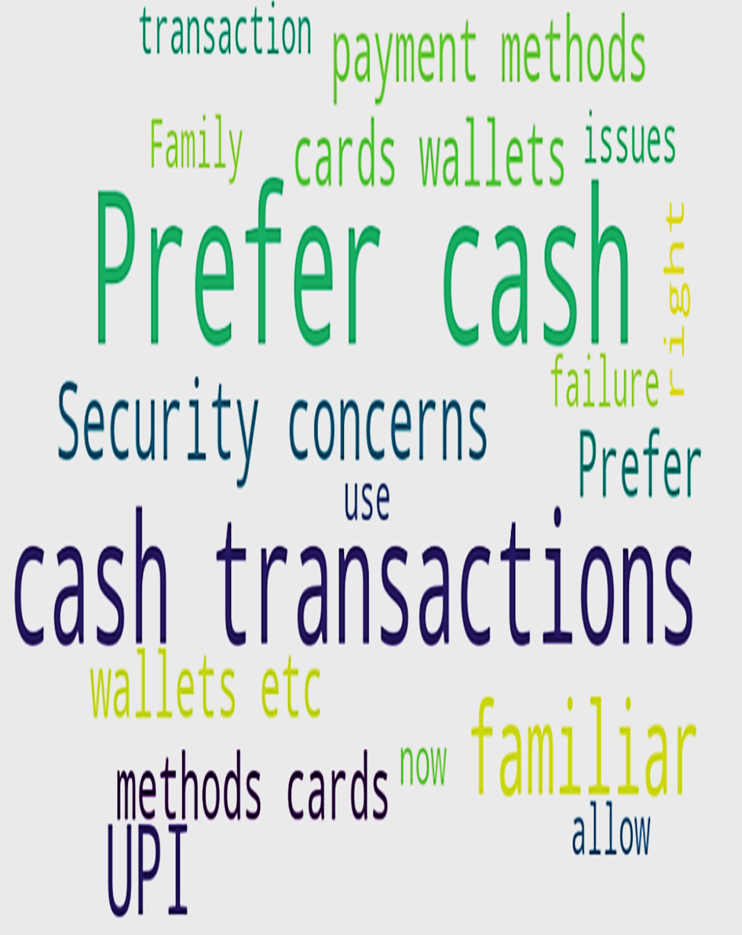
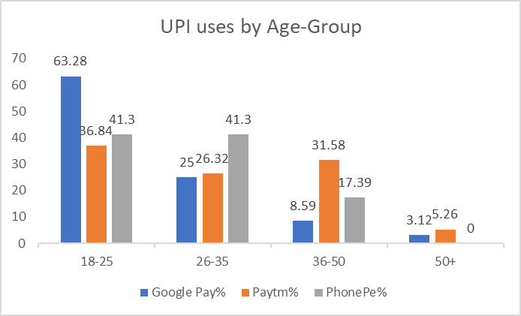
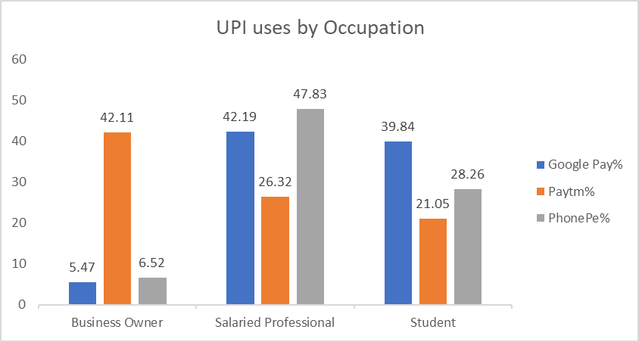

Slide 6

Chi-Square Test
Chi-square test results show significant associations between UPI app usage and Age Group
(p = 2.744e-07), Gender (p = 1.349e-04), and Occupation (p = 1.617e-17).
This indicates that preferences for UPI apps vary notably across age, gender, and occupation groups.
H0: The two categorical variables are independent (no association).
Vs
H1:The two categorical variables are associated (not independent).
Categories | Chi-Sq. Statistics | DF | P - Value
Age Group | 59.7868 | 15 | 2.744e-07
Gender | 25.0727 | 5 | 1.349e-04
Occupation | 137.5225 | 25 | 1.617e-17

Slide 7
Kruskal-Wallis Test
H0: The distribution of transaction speed satisfaction is the same across all UPI apps (Google Pay, PhonePe, and Paytm).
vs
H1 : At least one UPI app has a different distribution of transaction speed satisfaction.
User satisfaction significantly varies across UPI apps for Transaction Speed,Bill Payment, Payment Reminder, Security Features, User Interface and Merchant & Bank Support (p < 0.05).
However, no significant differences were found for Payment Reminder.
Post-hoc analysis like Dunn's test is recommended to identify specific app-wise differences.
Satisfaction Category | H-Statistic | P-Value | Conclusion
Transaction Speed | 11.2821 | 0.0035 | Significant Difference
Bill Payment | 15.5472 | 0.0004 | Significant Difference
Payment Reminder | 2.1335 | 0.3441 | No Significant Difference
User Interface | 6.5252 | 0.0383 | Significant Difference
Security Features | 9.4317 | 0.0090 | Significant Difference
Merchant & Bank Support | 21.8054 | 0.0000 | Significant Difference

Slide 8
Dunn Test
H0 : There is no significant difference between the two groups being compared.
VS
H1 : There is a significant difference between the two groups being compared
The Dunn's test revealed no significant differences in satisfaction with security features across Google Pay, Paytm, and PhonePe.
However, a significant difference was found in Transaction Speed Bill Payment, Merchant & Bank Support satisfaction between Google Pay and PhonePe (p<0.05), while Paytm vs. Google pay showed a near-significant result for Bill payment.
 | Adj P-value
Group 1 | Google Pay | Google Pay | Paytm
Group 2 | Paytm | PhonePe | PhonePe
Transaction Speed | 1 | 0.0151 | 1
Bill Payment | 0.06372 | 0.02048 | 1
User Interface | 1 | 0.2222 | 1
Security features | 0.3027 | 0.3187 | 1
Merchant & Bank Support | 0.4118 | 0.00035 | 1

Slide 9

Factor Analysis
V1) Transaction speed | V9) Ease of linking bank accounts
V2) Security & Fraud Protection | V10) Dependency on cash/cards
V3) Cashback/Reward | V11) Frequency of digital transactions
V4) Ease of use | V12) Ability to track expenses
V5) Transaction limits | V13) Bill Payments & Subscription Management habits
V6) 24/7 Customer Support Availability | V14) Savings habits
V7) Payment Reminder Feature | V15)Impulse buying behavior
V8) User interface & experience' | V16)Payment convenience at small/local merchant
V19 Satisfaction | V23 Recommendation of App by User
These variables focus on the outcome of the Uses after an interaction with the App.
Satisfaction measure show satisfied a user is with a particular app
Recommendation of app involves if a user would recommend using his/her UPI App to others.
These variables would be used as dependent variables.

Slide 10
KMO Measure
Bartlett’s Test of Sphericity
Now will perform a KMO test on the data after dropping the variable. This method followed is iterative like a backward elimination and would settle when all the un-relevant variables are removed.
Bartlett's test of sphericity tests the hypothesis that your correlation matrix is an identity matrix, which would indicate that your variables are unrelated and therefore unsuitable for structure detection.
KMO value | 0.787216
H0 : The observed variables in the dataset are uncorrelated in the population.
Vs
H1 : The observed variables in the dataset are correlated in the population.
Variable No. | KMO Value
1 | 0.796
2 | 0.719
3 | 0.821
4 | 0.834
5 | 0.814
6 | 0.838
7 | 0.785
8 | 0.843
9 | 0.847
10 | 0.731
11 | 0.794
12 | 0.706
13 | 0.833
14 | 0.540
15 | 0.743
16 | 0.725
Output of Bartlett’s test of Sphericity:
Chi-Square value=1337.6064 , p-value=1.358e-204
Here as we can see form the result p-values id less than 0.05 level of significance.
Thus we have sufficient evidence to Reject Null Hypothesis.
Concluding that the variables are correlated enough for a factor analysis.

Slide 11
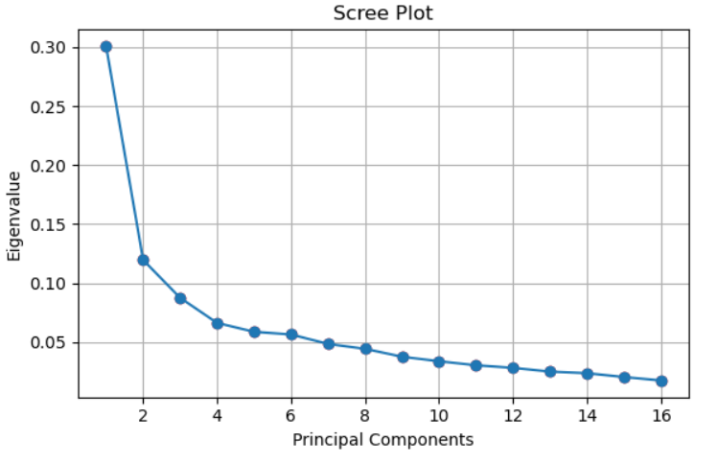
Determining the no. of factors to be derived:
Component | Eigenvalue | Explained Variance Ratio | Cumulative Variance Explained
1 | 4.360834 | 0.3005 | 0.3005
2 | 2.225615 | 0.1197 | 0.4202
3 | 1.393769 | 0.0876 | 0.5078
4 | 1.079703 | 0.0664 | 0.5742
5 | 0.979367 | 0.0588 | 0.633
6 | 0.895002 | 0.0566 | 0.6896
7 | 0.749668 | 0.0486 | 0.7381
8 | 0.671284 | 0.0444 | 0.7825
9 | 0.63058 | 0.0377 | 0.8202
10 | 0.581187 | 0.0339 | 0.8542
11 | 0.533182 | 0.0305 | 0.8847
12 | 0.454739 | 0.0283 | 0.913
13 | 0.440666 | 0.0251 | 0.9381
14 | 0.35491 | 0.0238 | 0.9619
15 | 0.333875 | 0.0205 | 0.9824
16 | 0.315621 | 0.0176 | 1
Thus we will keep 8 Factors for the Factor Analysis .

Slide 12
Factor Analysis:
After analysing the data extensively by trying orthogonal and oblique rotations like Varimax, Quartimax, Equamax and Oblimin. Equamax suited the most for further analysis. Thus, Using Equamax Rotation.
Variables/Factors | F1 | F2 | F3 | F4 | F5 | F6 | F7 | F8
Transaction speed |  | - | - | - | - | - | 0.54279 | -
Security & Fraud Protection | 0.855539 | - | - | - | - | - | - | -
Cashback/Reward | - | - | - | - | 0.878998 | - | - | -
Ease of use | - | - | - | - | 0.574848 | - | - | -
Transaction limits | - | - | - | - | - | 0.68096 | - | -
24/7 Customer Support Availability | 0.56073 | - | - | - |  | - | - | -
Payment Reminder Feature | - | - | - | - | - | 0.78912 | - | -
User interface & experience |  | - | - | - | - | 0.54154 | - | -
Ease of linking bank accounts | 0.777357 | - | - | - | - | - | - | -
Dependency on cash/cards | - | 0.82602 | - | - | - | - | - | -
Frequency of digital transactions | - | 0.74315 | - | - | - | - | - | -
Ability to track expenses | - | - | - | 0.81013 | - | - | - | -
Bill Payments & Subscription Management habits | - | - | - | - | - | - | - | 0.83768
Savings habits | - | - | 0.88234 | - | - | - | - | -
Impulse buying behavior | - | - | 0.53847 | - | - | - | - | -
Payment convenience at small/local merchant | - | - | - | - | - | - | 0.81044 | -
Total Proportion of variance explained by the 8 factors 75%
F1
Reliability
Digitalization
Spending
Tracking Expenses
Usability
Functionality
Convenience
Payments
F2
F3
F4
F5
F6
F7
F8

Slide 13
Distribution of Variables Across Factors
Security and Fraud protection
F1 : Reliability
24/7 Customer Support
Ease of Linking Bank Acc.
Transaction Limit
Payment Reminder
F6 : Functionality
Dependency on Card/Cash
F2 : Digitalization
User Interface
Frequency of Digital transaction
Transaction Speed
F7 : Convenience
Impulse Buying Behavior
F3 : Spending
Payment Convenience
Saving Habits
F4 : Tracking Expenses
Bill Payment and Subscription Management
F8 : Payments
Ability to Track Expenses
Cashback and Reward
F5 : Usability
Ease of Use

Slide 14
Recommendation & User Satisfaction
Dependent Variable
Y=Would you recommend your UPI app to others ?
Y1=How satisfied are you with your primary UPI app overall ?
Independent Variables
X1=Reliability
X2=Digitalization
X3=Spending
X4=Tracking expenses
X5=Usability
X6=Functionality
X7=Convenience
X8=Payments

Slide 15
Binary Logistic Regression
Recommendation of App by User
Result
F1-score | Precision | Recall
0.74035 | 0.7692 | 0.7142
The model performs well (F1-score: 0.74), with strong precision (77%) and recall (71%) in predicting UPI app recommendations.
Reliability is the top predictor, followed by Functionality and Tracking Expenses, boosting recommendation likelihood.
Digitalization, Spending, and Payments help mildly; Usability and Convenience has minimal effect.
Odds Ratio
Feature | Coefficient | Odds_Ratio
Reliability | 0.716356 | 2.04696
Functionality | 0.520882 | 1.683511
Tracking expenses | 0.386488 | 1.471802
Digitalization | 0.185343 | 1.203631
Spending | 0.169101 | 1.18424
Payments | 0.086441 | 1.090287
convenience | 0.035238 | 1.035867
Usability | 0.020792 | 0.922386

Slide 16
Binary Logistic Regression
User Satisfaction
Result
F1-score | Precision | Recall
0.6666 | 0.7666 | 0.5897
The model shows moderate performance (F1-score: 0.6666) with good precision (76.66%) but lower recall (58.97%).
Reliability (OR = 1.815) is the strongest predictor of user satisfaction, followed by Functionality, Payments, and Usability.
Features like Convenience and Digitalization also positively influence satisfaction, though to a lesser extent.
Odds Ratio
Feature | Coefficient | Odds_Ratio
Reliability | 0.596273 | 1.81534
Functionality | 0.483773 | 1.622183
Payments | 0.264791 | 1.303158
Usability | 0.250747 | 1.284985
Spending | 0.24985 | 1.283833
Tracking expenses | 0.170305 | 1.185666
Convenience | 0.110539 | 1.116879
Digitalization | 0.09416 | 1.098735

Slide 17
Decision Tree
User Satisfaction
Result
The Decision Tree model (F1-score: 0.6645) has higher recall (71.79%) than precision (65.11%), making it better at identifying most satisfied users, though with more false positives.
F1-score | Precision | Recall
0.6645 | 0.6511 | 0.7179

Slide 18
Conclusion
1
The study revealed a 93.4% UPI adoption rate, with Google Pay and PhonePe dominating usage App preference significantly varied by age, gender, and occupation.
2
Users rated transaction speed and UI similarly across apps, significant differences were observed in satisfaction with features like bill payments, security, payment reminders, and merchant support.
3
Factor analysis identified eight core dimensions (e.g., Reliability, Usability, Functionality) influencing user satisfaction and app recommendation behavior.
4
Logistic regression and decision tree models showed Reliability and Functionality as the strongest predictors of user satisfaction and likelihood to recommend UPI apps.
5
Common user challenges included transaction failures and security concerns, indicating the need for better app stability, fraud prevention, and user awareness to enhance trust and engagement.

Slide 19
References
Link to Git-hub repository: https://github.com/nextthreshold/AnalyzingUPIApps
Questionnaire : https://forms.gle/qnYc9JCGVXzwGMhwReferences
“Applied Multivariate Statistical Analysis” by Richard A. Johnson & Dean W. Wichern▪
"Mathematical Statistics and Data Analysis" by John A. Rice▪
"Statistical Inference" by George Casella and Roger L. Berger

Slide 20
Thank You!

